Slide 1
Software Defined Radio Transmitter using ADALM-Pluto
Presented by: [Group 3 – I]
  Nagasushma Karnati
  Sneha Potadar
  Alireza Asgari
  Manzoor Ambekar
  Saptarshi Chakravorty
Department of Information and
Electrical Engineering

Slide 2
INTRODUCTION
Software-defined radio (SDR) is a radio communication system where components that have been traditionally implemented in analog hardware are instead implemented by means of software.
SDR is a common parameter and package, which is used to implement the own communication between transmitter and Receiver.
To implement SDR we are using the ADALM-Pluto as a transceiver.
Adalm Pluto features independent transmit and receive signals capable of operating in full-duplex.
Although, we have implemented simplex transmitter using the Adalm Pluto.

Slide 3
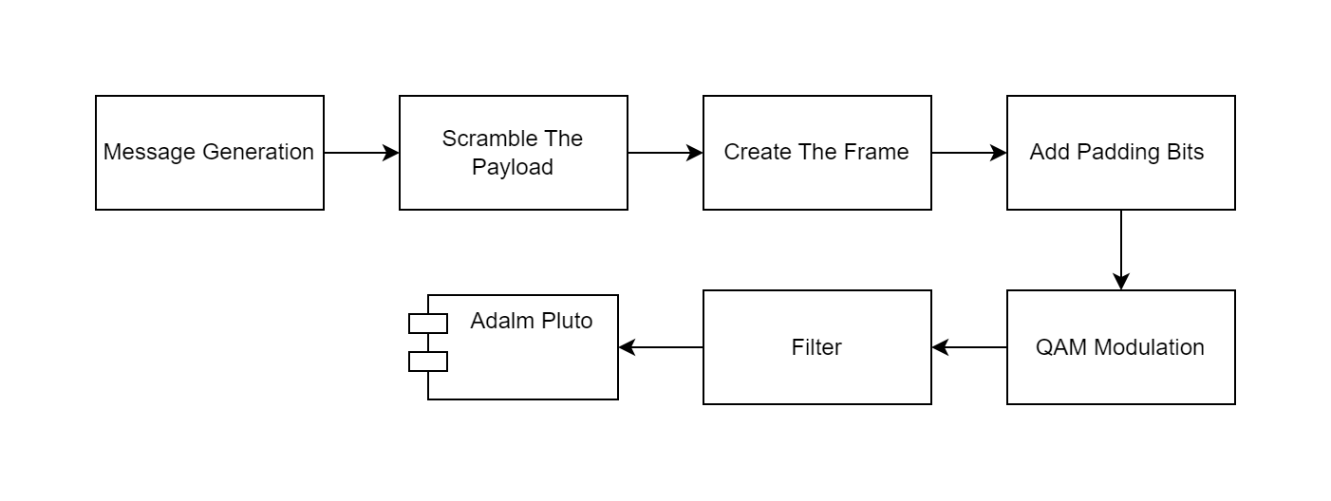
Block Diagram

Slide 4
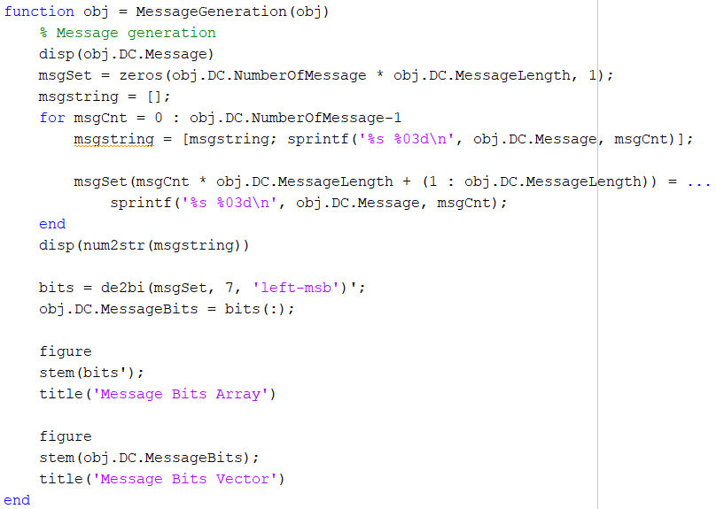
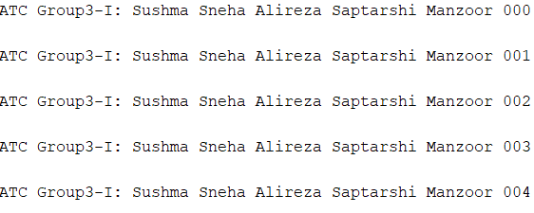
Message Generation

Slide 5
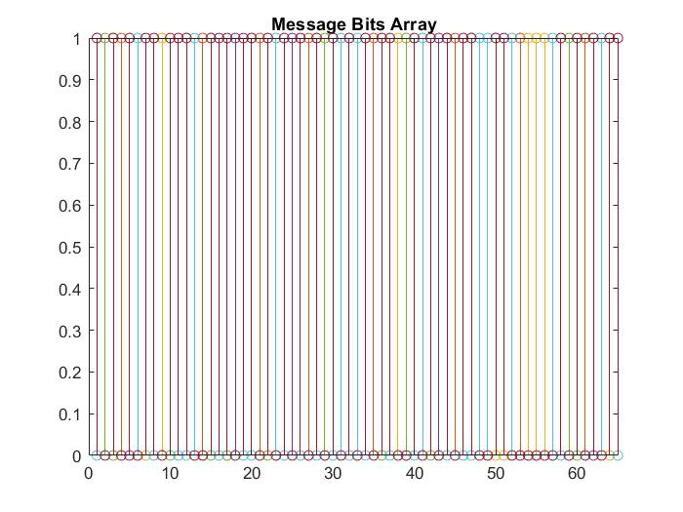
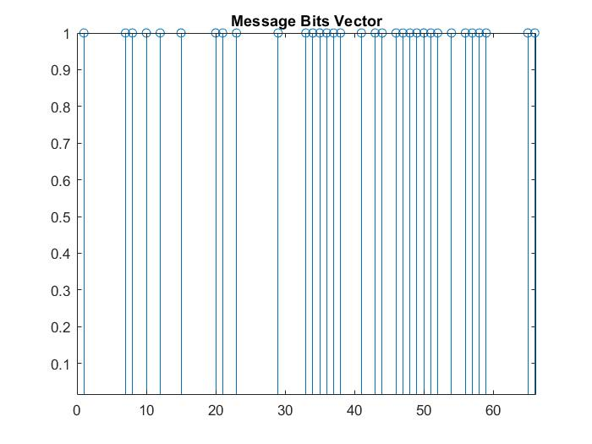

Slide 6
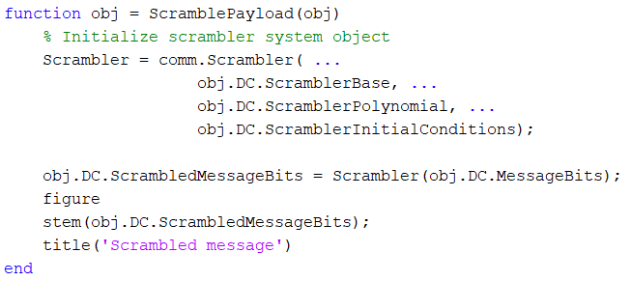
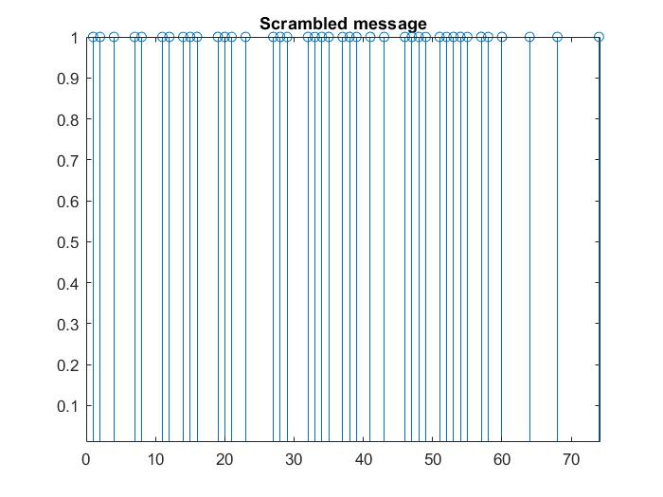
Scramble the Payload

Slide 7
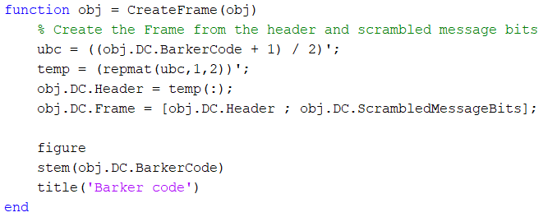
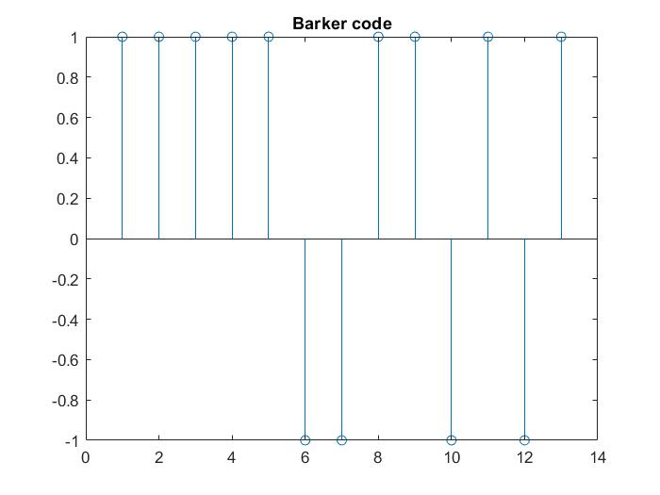
Create The Frame

Slide 8
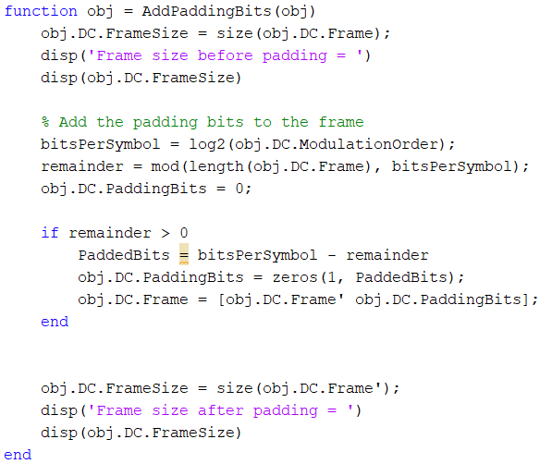
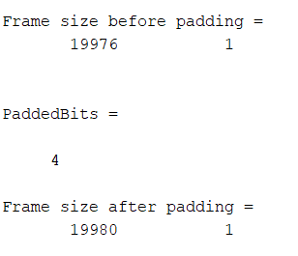
Add The Padding Bits

Slide 9
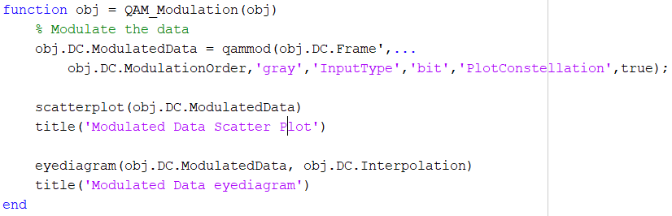
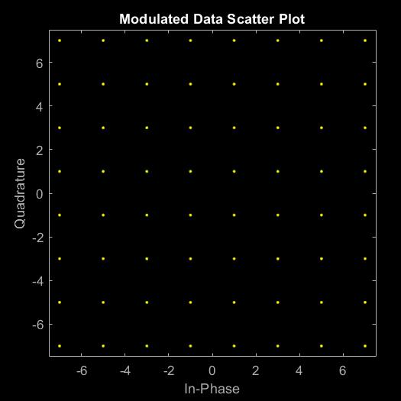
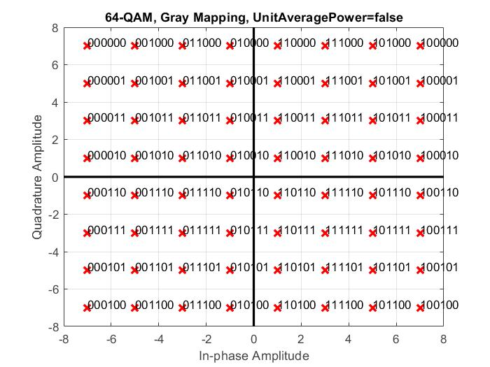
QAM Modulation

Slide 10
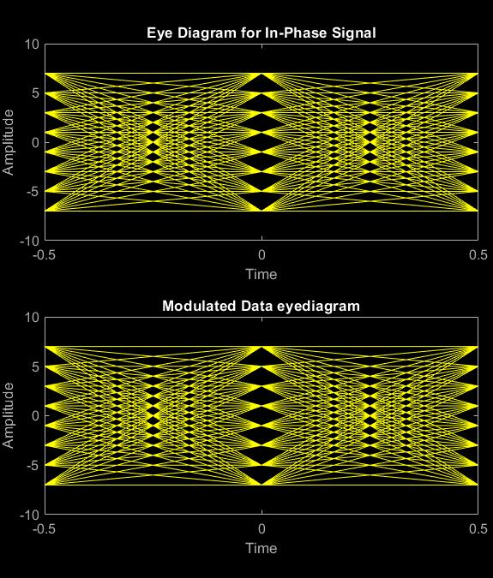

Slide 11
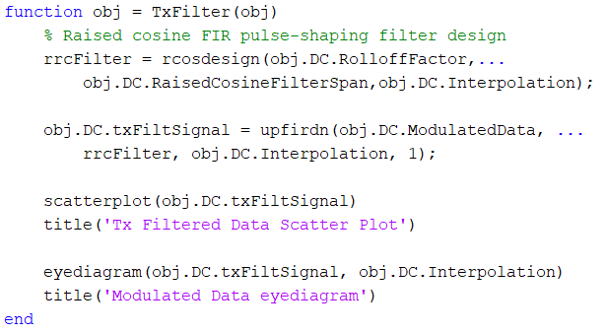
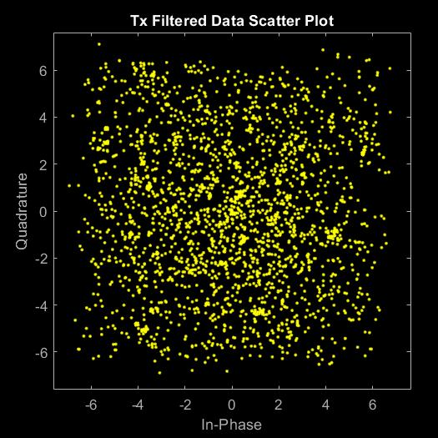
Filter

Slide 12
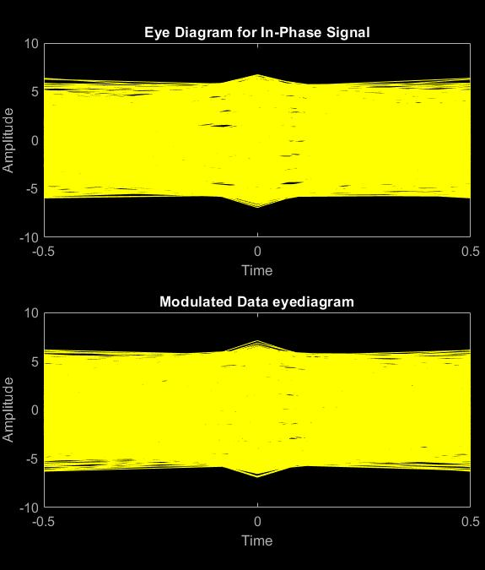

Slide 13
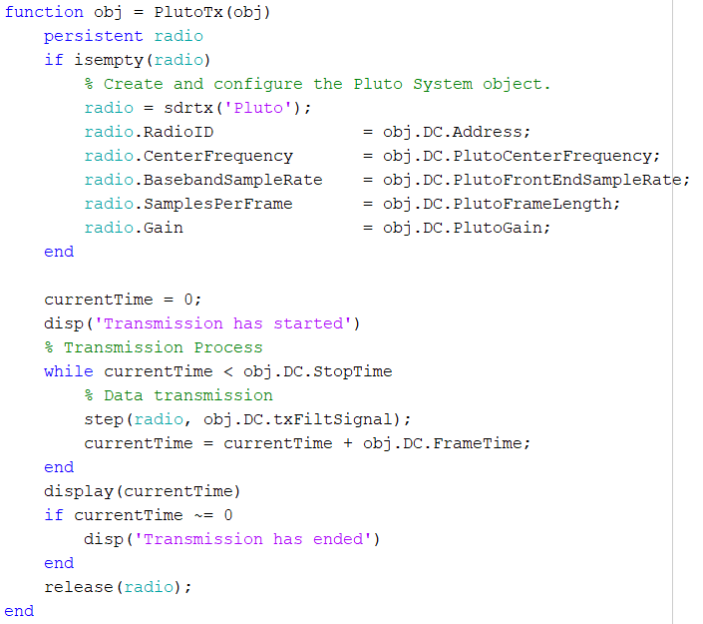
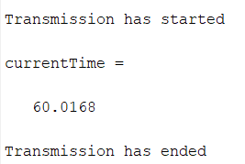
Adalm Pluto

Slide 14
Conclusion
As part of this lab work, we implemented and understood the overall flow of the SDR. That is, how message is transformed and ready to be transmitted via the Adalm Pluto.
We have implemented a flexible QAM transmitter in the MATLAB. Where, we have transmitted the message with 52 number of characters, and repeating it for 50 times.
Transmit power is kept at -4dB, along with the symbol rate at 150k, center frequency as 1.20GHz with QAM64-scheme.

Slide 15
Thank you for your attention!
Any Questions?

